Slide 1
Computer Security Team Project

Slide 2
introduction
Demo
01
04
challenges
conclusion
02
05
Techniques
03
A small overview about our project
A brief about techniques used on our project
Challenges we’ve gone through implementing this project
Snapshots from our project
A small description about our project goals

Slide 3
Our Team
Abdelrahman ghoniem
Mohammed abdelmotaleb
Mohammed osama
Mohammed alammar

Slide 4
01
OVERVIEW

Slide 5
Introduction
We chose to represent out computer security through implementing a calculator interface that encypts the plain text and decrypts it through 1 of 4 techniques we have in our Curriculum

Slide 6
Used languages
1st html
2nd css
3rd Js

Slide 7
02
challenges
You could enter a subtitle here if you need it

Slide 8
challenges
Key Management
Key Distribution
Algorithm Complexity
Each encryption technique requires a key or keys for encryption and decryption. Managing these keys securely is crucial. If keys are lost or compromised, it can lead to the exposure of sensitive information.
Ensuring that both the sender and receiver have access to the correct keys can be challenging, especially in scenarios where secure channels for key exchange are not available.
Some encryption techniques, particularly poly-alphabetic ciphers like the Vigenère cipher, can be complex to implement and understand. Ensuring the correct implementation of these algorithms is essential for their effectiveness.

Slide 9
challenges
Cryptanalysis
Performance
Security Risks
All encryption techniques are subject to cryptanalysis, where attackers attempt to break the encryption and recover the plaintext without knowledge of the key. Some techniques, such as the Caesar cipher, are vulnerable to brute-force attacks due to their simplicity, while others, like the Playfair cipher, require more sophisticated attacks.
Encryption and decryption operations can introduce computational overhead, especially for more complex algorithms or large volumes of data. Balancing security requirements with performance considerations is important, particularly in resource-constrained environments.
Depending on the specific implementation and usage, encryption techniques can be vulnerable to various attacks such as chosen-plaintext attacks, known-plaintext attacks, or frequency analysis. Understanding these vulnerabilities and mitigating them is essential for robust security.

Slide 10
03
Techniques

Slide 11
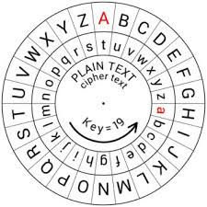
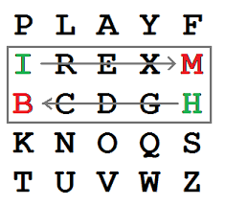
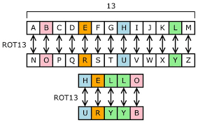
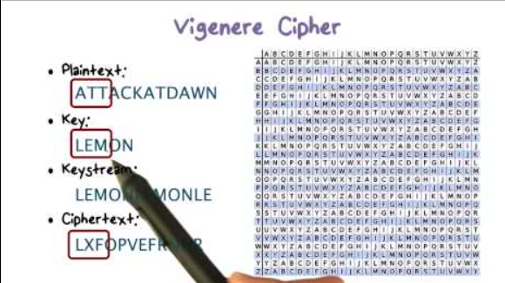
techniques
Caesar cipher
Playfair cipher
Monoalphabetic cipher
Poly alphabetic
shifts each letter by a fixed number of positions, providing elementary encryption often used for educational purposes rather than robust security.
substitutes pairs of letters with predefined rules, offering a more secure alternative to simple substitution ciphers.
replaces each plaintext letter with a unique ciphertext letter, making it vulnerable to frequency analysis but straightforward to implement.
like the Vigenère cipher, use multiple alphabets to encrypt text, complicating cryptanalysis by varying the substitution alphabet with each letter.

Slide 12
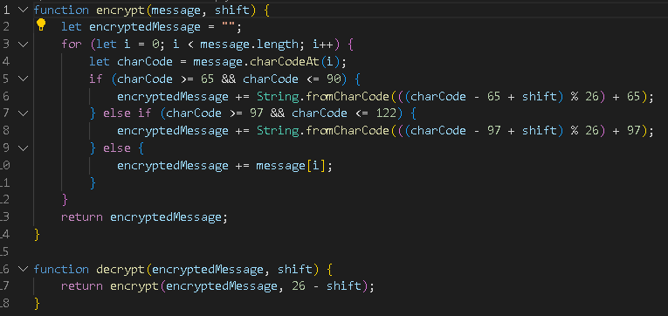
techniques
1st Caesar cipher

Slide 13
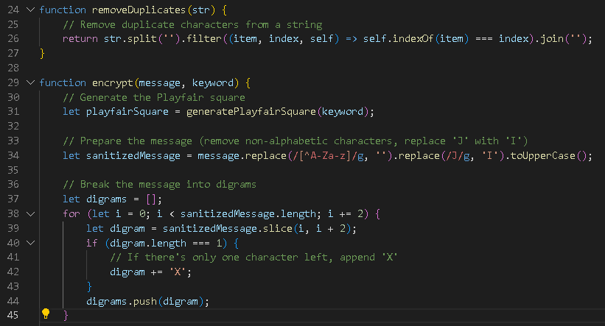
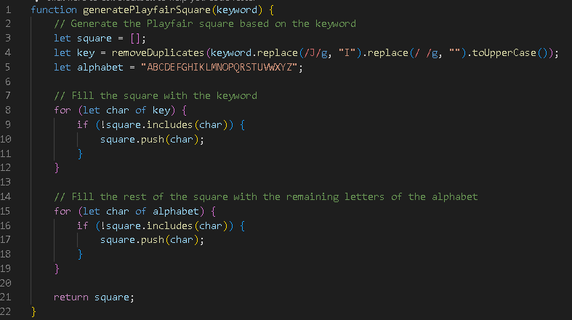
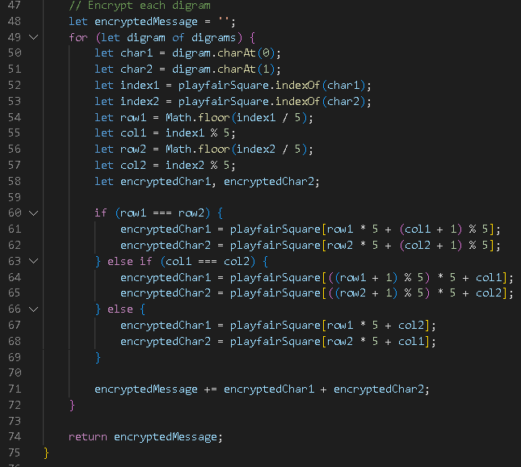
techniques
2nd playfair

Slide 14
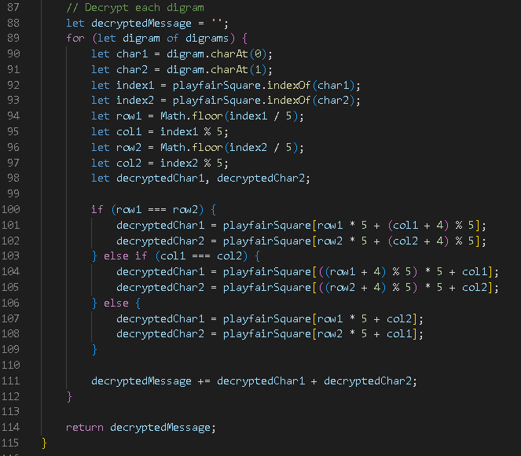
techniques
2nd playfair

Slide 15
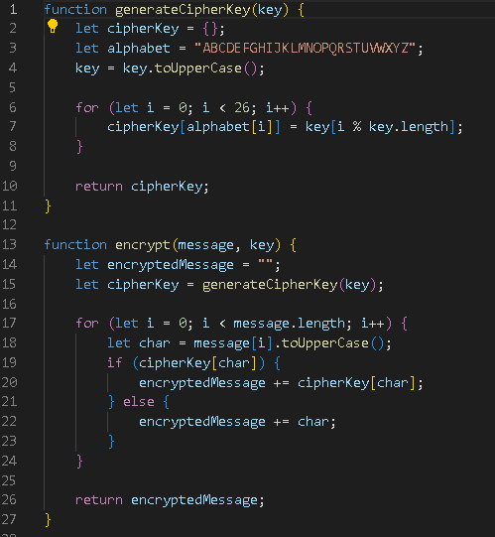
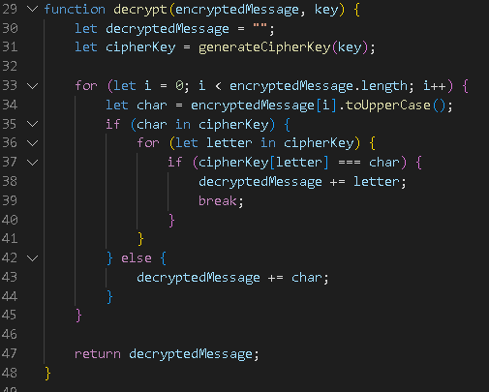
techniques
3rd monoalphabetic

Slide 16
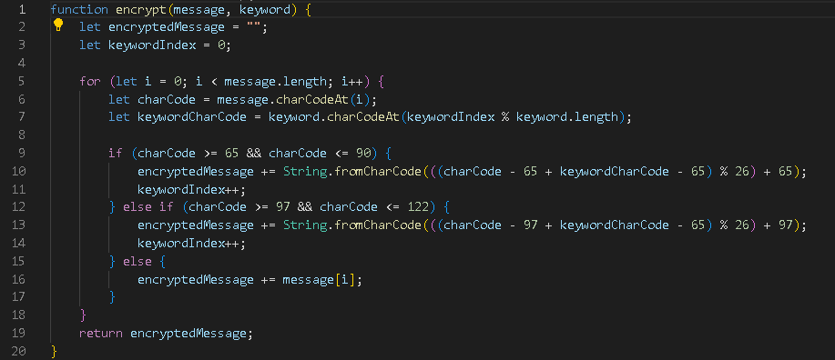
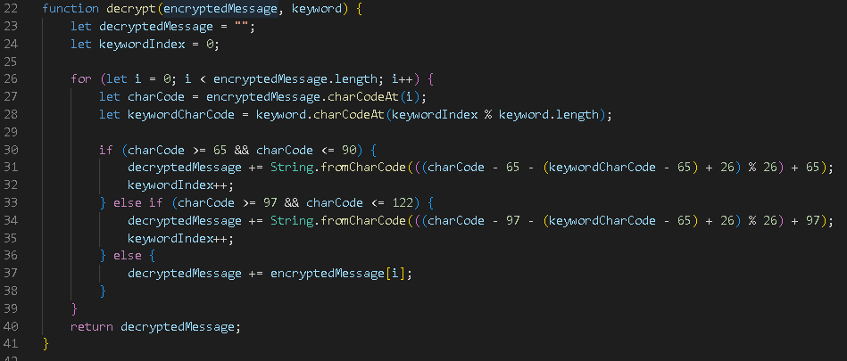
techniques
4th poly-alphabetic

Slide 17
04
Demo
You could enter a subtitle here if you need it

Slide 18
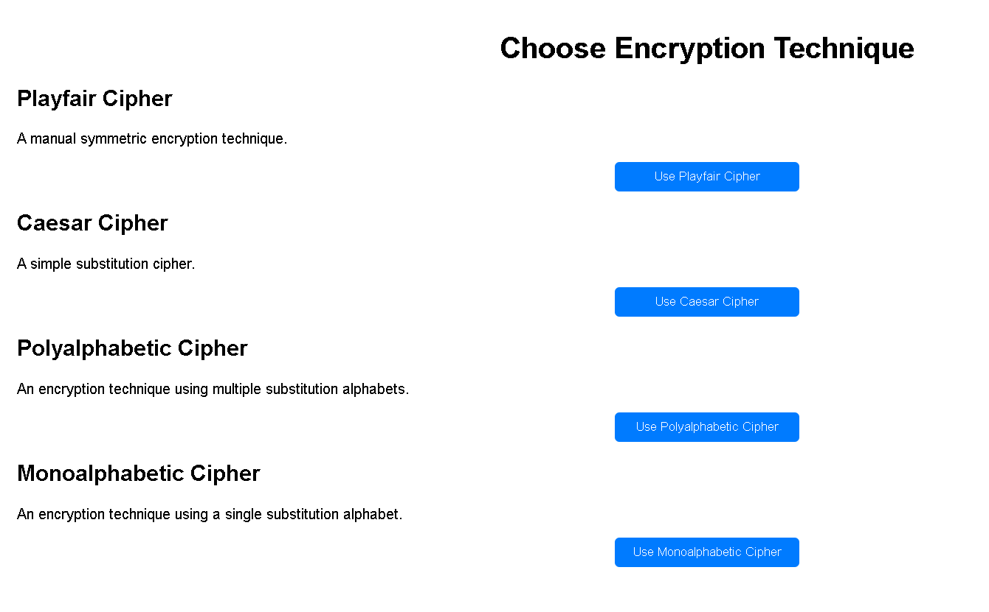
Demo
1-Home page

Slide 19
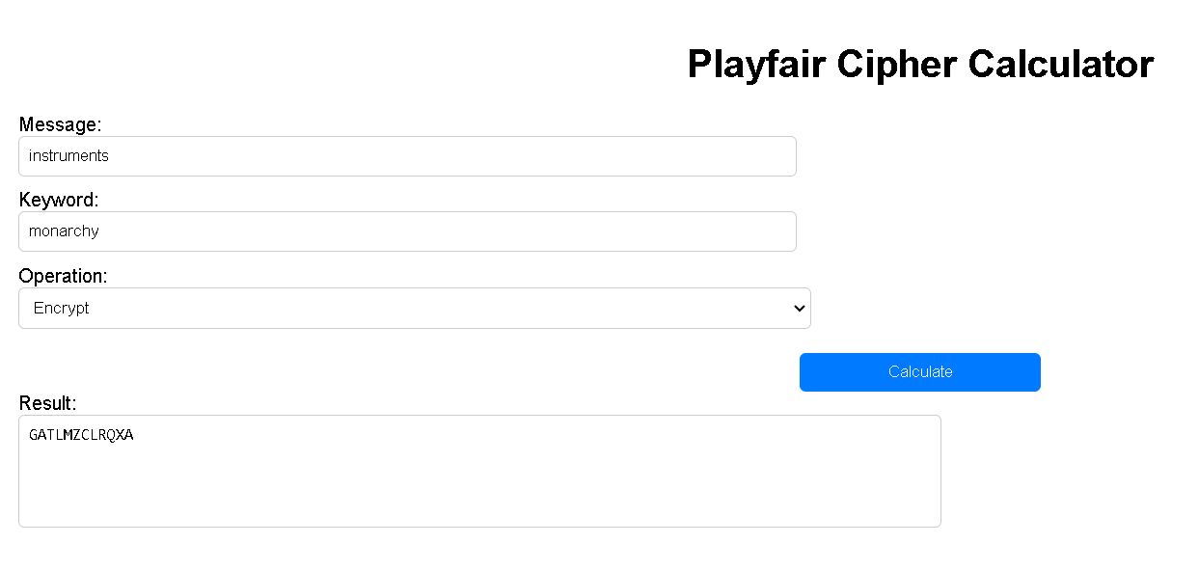
Demo
2-Playfair

Slide 20
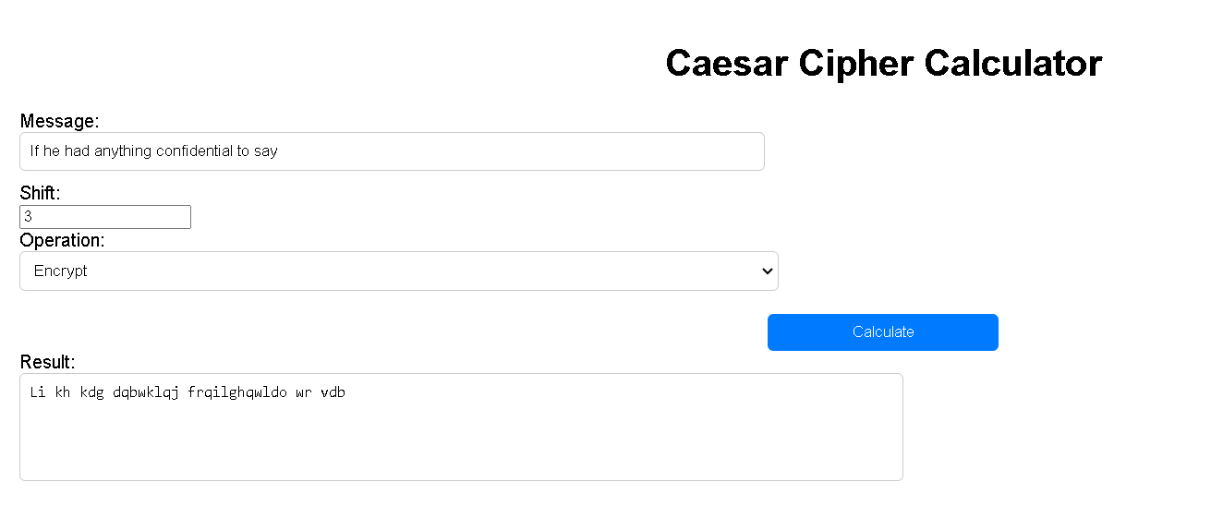
Demo
3-Caesar cipher

Slide 21

Demo
3-poly-alphabetic (vigenere) cipher

Slide 22
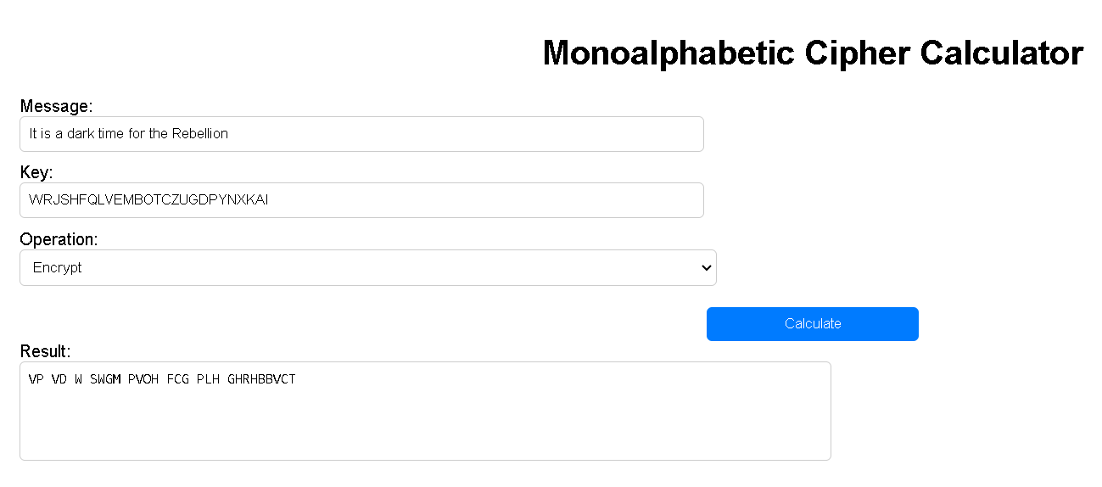
Demo
5-mono-alphabetic cipher

Slide 23
05
Conclusion
You could enter a subtitle here if you need it

Slide 24
Conclusion
In conclusion, our Encrypting Calculator website offers versatile encryption techniques catering to users' diverse security needs. From classic ciphers to modern algorithms, we empower users of all levels to safeguard their data effectively. Join us in fortifying the digital landscape and ensuring a safer online experience for all.

Slide 25
THANKS!
Do you have any questions?

